Slide 1
How to best use these slides…
View the PPT as a slide show
Then click through every step
Mouse clicks will advance the slide show
Left/right arrow keys move forward/backward
Mouse wheel scrolling moves forward/backward
When a question is posed, stop and think it through, try to answer it yourself before clicking
If you have questions, email me, ask in the Teams Student Center channel!

Slide 2
LESSON 6.5a
Properties of Logarithms

Slide 3
Today you will:
Use the properties of logarithms to evaluate logarithms.
Use the properties of logarithms to expand or condense logarithmic expressions.
Practice using English to describe math processes and equations

Slide 4
Previous Vocabulary:
Base of exponential function
Base of logarithmic function
Properties of exponents

Slide 5
Exponential Function
Variable is in the exponent!
$$y=ab^{x}$$
Leading coefficient
Base
Not a variable, just a number

Slide 6
Logarithm
Another way of writing $y=b^{x}$
$$\log_{b}{y}=x$$
Read it as “Log base $b$ of $y$ is $x$”
…as an exponential function it is $b$ to the $x$ is $y$

Slide 7
$$a^{m}a^{n}=a^{m+n}$$
$$\frac{a^{m}}{a^{n}}=a^{m−n}$$
$${\left(a^{m}\right)}^{n}=a^{mn}$$
Three Basic Properties of Exponents

Slide 8

$$\log_{b}{mn}=\log_{b}{m}+\log_{b}{n}$$
$$\log_{b}{\frac{m}{n}}=\log_{b}{m}−\log_{b}{n}$$
$$\log_{b}{m^{n}}={nlog}_{b}{m}$$
Three Basic Properties of Logarithms

Slide 9
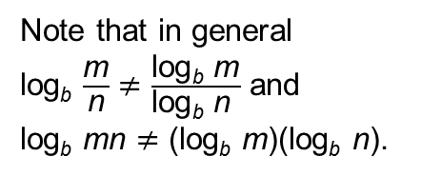
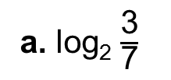
Use log₂ 3 $≈$ 1.585 and log₂ 7 $≈$ 2.807 to evaluate each logarithm.
a. log₂ $\frac{\text{3}}{\text{7}}$
b. log₂ 21
c. log₂ 49
SOLUTION
a. log₂ $\frac{\text{3}}{\text{7}}$ $=$ log₂ 3 $−$ log₂ 7
Quotient Property
$≈$ 1.585 $−$ 2.807
Use the given values of log₂ 3 and log₂ 7.
$=$ $−$1.222
Subtract.
Note that in general
log_{b} $\frac{\text{m}}{\text{n}}$ $≠$ $\frac{\text{log}\text{b} \text{m}}{\text{log}\text{b} \text{n} }$ and
log_{b} mn $≠$ (log_{b} m)(log_{b} n).
b. log₂ 21 $=$ log₂(3 $\text{•}$ 7)
Write 21 as 3 $\text{•}$ 7.
$=$ log₂ 3 + log₂ 7
Product Property
$≈$ 1.585 $+$ 2.807
Use the given values of log₂ 3 and log₂ 7.
$=$ 4.392
Add.
c. log₂ 49 $=$ log₂ 7²
Write 49 as 7².
$=$ 2 log₂ 7
Product Property
$≈$ 2(2.807)
Use the given value log₂ 7.
$=$ 5.614
Multiply.

Slide 10
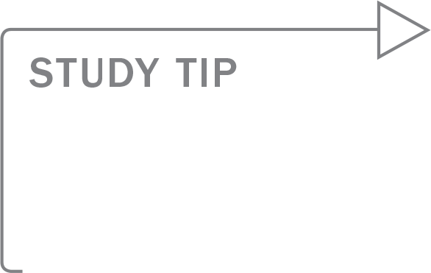
Expand ln $\frac{\text{5}\text{x}\text{7}}{\text{y}}$.
When you are expanding
or condensing an
expression involving
logarithms, you can
assume that any variables
are positive.
SOLUTION
ln $\frac{\text{5}\text{x}\text{7}}{\text{y}}$ $=$ ln 5x⁷ $−$ ln y
Quotient Property
$=$ ln 5 $+$ ln x⁷ $−$ ln y
Product Property
$=$ ln 5 $+$ 7 ln x $−$ ln y
Power Property

Slide 11
Condense log 9 $+$ 3 log 2 $−$ log 3.
SOLUTION
log 9 $+$ 3 log 2 $−$ log 3 $=$ log 9 $+$ log 2³ $−$ log 3
Power Property
$=$ log(9 $\text{•}$ 2³) $−$ log 3
Product Property
$=$ log $\frac{\text{9 }\text{•}\text{ 2}\text{3}}{\text{3}}$
Quotient Property
$=$ log 24
Simplify.

Slide 12
Homework
Pg 331, #3-32

